Slide 1
Retail Analytics Case Study
SQL PROJECT PRESENTATION

Slide 2
Overview
In the rapidly evolving retail sector, businesses continually seek innovative strategies to stay ahead of the competition, improve customer satisfaction, and optimize operational efficiency. Leveraging data analytics has become a cornerstone for achieving these objectives. This case study focuses on a retail company that has encountered challenges in understanding its sales performance, customer engagement, and inventory management. Through a comprehensive data analysis approach, the company aims to identify high or low sales products, effectively segment its customer base, and analyze customer behavior to enhance marketing strategies, inventory decisions, and overall customer experience.

Slide 3
Business Problem
The retail company has observed stagnant growth and declining customer engagement metrics over the past quarters. Initial assessments indicate potential issues in product performance variability, ineffective customer segmentation, and lack of insights into customer purchasing behavior. The company seeks to leverage its sales transaction data, customer profiles, and product inventory information to address the following key business problems:
Product Performance Variability: Identifying which products are performing well in terms of sales and which are not. This insight is crucial for inventory management and marketing focus.
Customer Segmentation: The company lacks a clear understanding of its customer base segmentation. Effective segmentation is essential for targeted marketing and enhancing customer satisfaction.
Customer Behaviour Analysis: Understanding patterns in customer behavior, including repeat purchases and loyalty indicators, is critical for tailoring customer engagement strategies and improving retention rates.

Slide 4
Objectives:
To utilize SQL queries for data cleaning and exploratory data analysis to ensure data quality and gain initial insights.
To identify high and low sales products to optimize inventory and tailor marketing efforts.
To segment customers based on their purchasing behavior for targeted marketing campaigns. Create Customer segments –
To analyze customer behavior for insights on repeat purchases and loyalty, informing customer retention strategies
Total Quantity of Products Purchased | Customer Segment
0 | No Orders
1–10 | Low
10–30 | Mid
>30 | High Value

Slide 5
Datasets Tables:
Sales Transaction: Records of sales transactions, including transaction ID, customer ID, product ID, quantity purchased, transaction date, and price.
Customer Profiles: Information on customers, including customer ID, age, gender, location, and join date.
Product Inventory: Data on product inventory, including product ID, product name, category, stock level, and price.

Slide 6
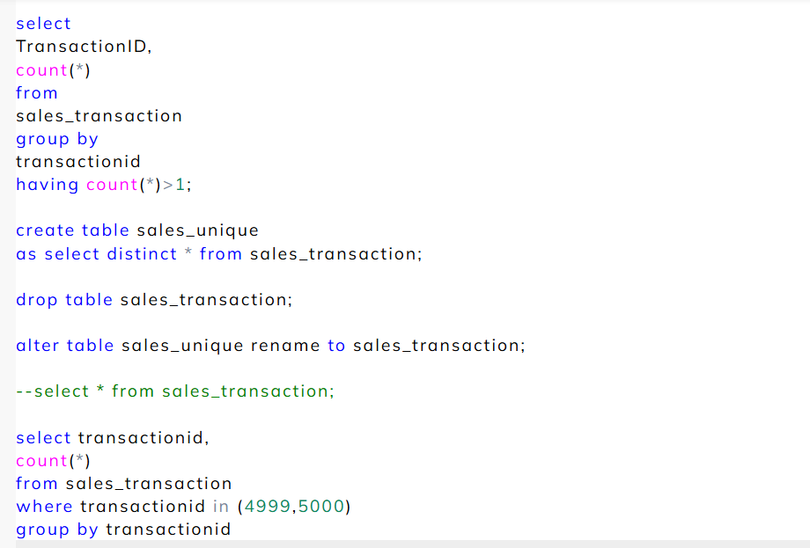
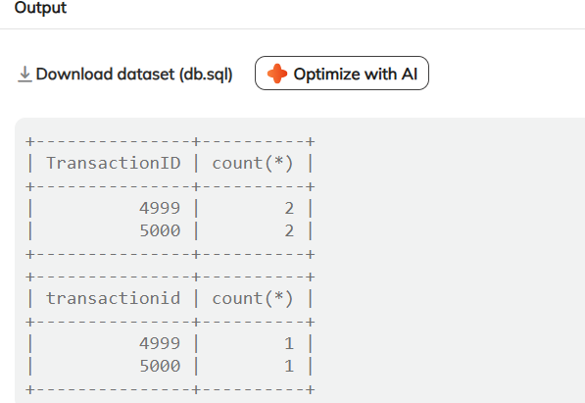
Problem Statement:
Remove Duplicates
SQL Query
Analysis:
Duplicate records were detected for Transaction IDs 4999 and 5000, which were removed using SQL data cleaning. The process ensured each transaction appeared only once, improving data accuracy and reliability. This enhances the quality of future sales and inventory analysis.

Slide 7
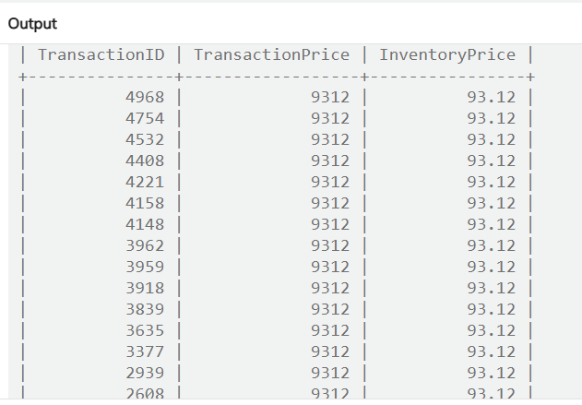
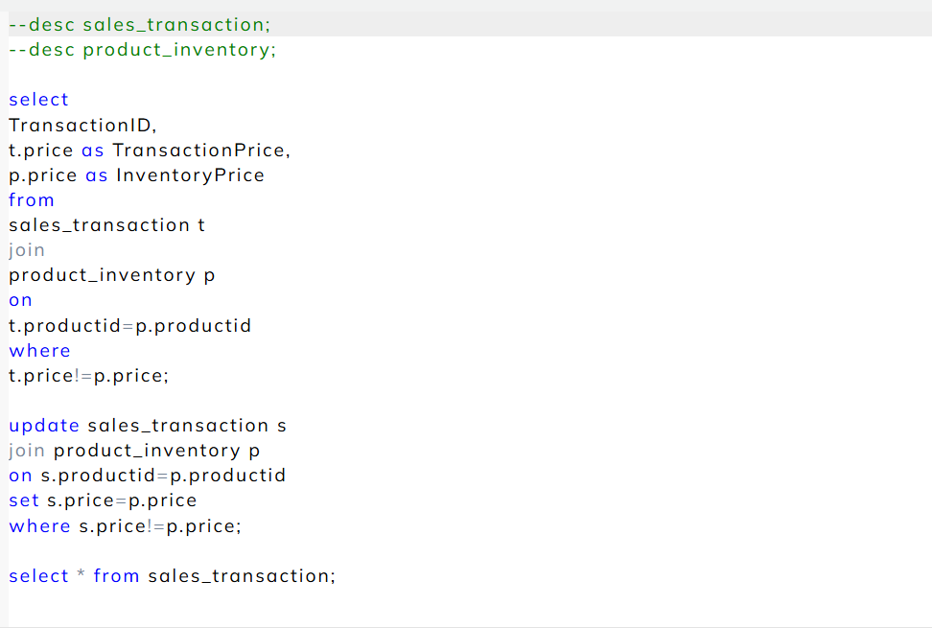
Problem Statement:
Fix Incorrect Prices
SQL QUERY
Analysis:
Incorrect pricing discrepancies were identified between the sales_transaction and product_inventory tables. Using SQL joins and update queries, transaction prices were aligned with the correct inventory prices. This correction ensured consistency across datasets, improving pricing accuracy and reliability for financial and sales reporting.

Slide 8
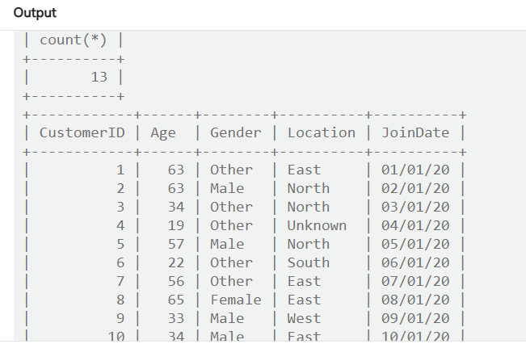
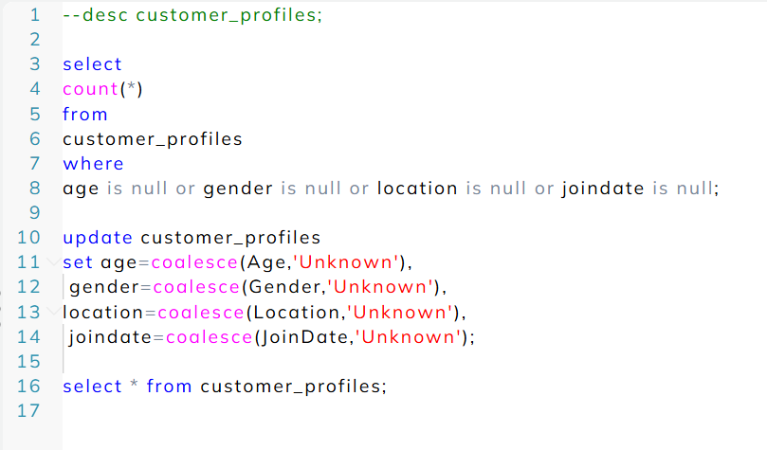
Problem Statement : Fixing Null Values
SQL QUERY
Analysis:
Null values were identified in key customer attributes such as age, gender, location, and join date. Using the COALESCE function, these missing fields were replaced with the placeholder “Unknown,” ensuring data completeness. This process improved dataset consistency and enabled more accurate customer segmentation and reporting.

Slide 9
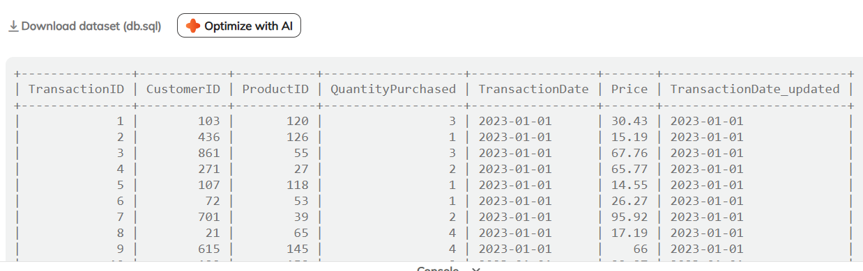
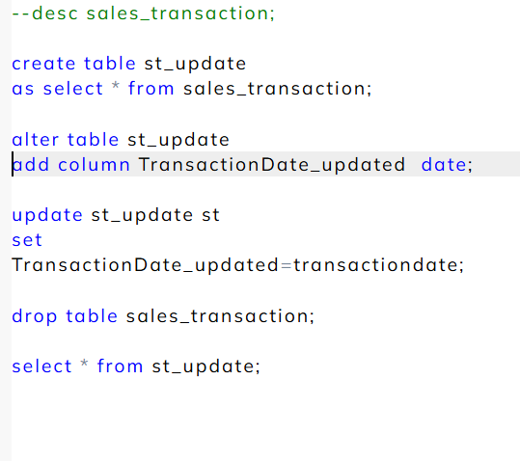
Problem Statement:
Cleaning Date
SQL QUERY
Analysis:
A new column was created to clean and standardize transaction dates in the dataset. The updated date format ensured uniformity across all records, resolving inconsistencies and improving data readiness for time-based analysis. This step enhances the accuracy of sales trend tracking and reporting.

Slide 10
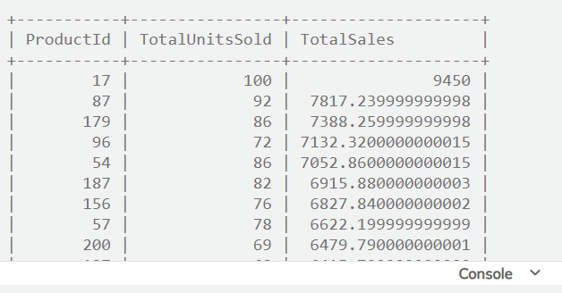
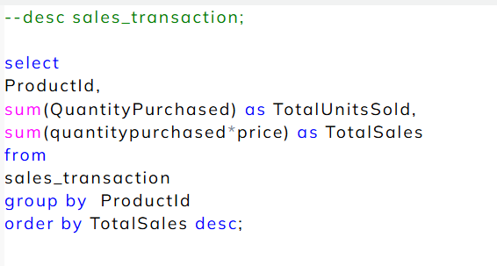
Problem Statement:
Total Sales Summary
SQL QUERY
Analysis:
The analysis summarizes total sales performance by product, identifying the best-selling items based on both quantity sold and total revenue. Products with higher total sales indicate strong market demand, guiding inventory planning and promotional strategies to maximize profitability.

Slide 11
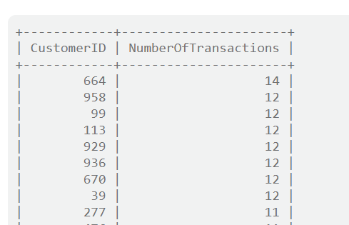
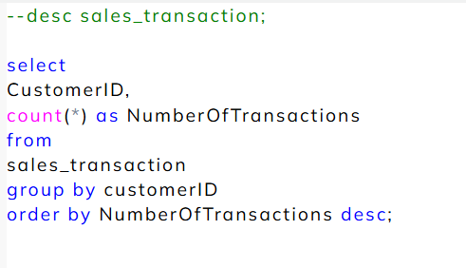
Problem Statement:
Customer Purchase Frequency
SQL QUERY
Analysis:
The analysis identifies customers with the highest number of transactions, highlighting frequent buyers who contribute significantly to overall sales. These insights help in recognizing loyal customers, enabling targeted marketing and personalized engagement strategies to improve retention and repeat purchases.

Slide 12
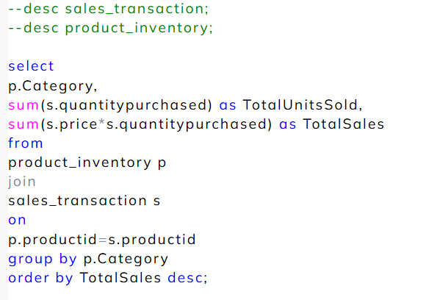
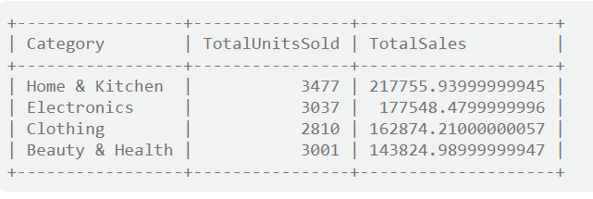
Problem Statement:
Product Categories Performance
SQL QUERY
Analysis:
The analysis highlights category-wise sales performance, showing that Home & Kitchen leads in both total units sold and revenue, followed by Electronics and Clothing. These insights help identify top-performing categories, guiding inventory allocation, marketing focus, and future sales strategies to maximize profitability.

Slide 13
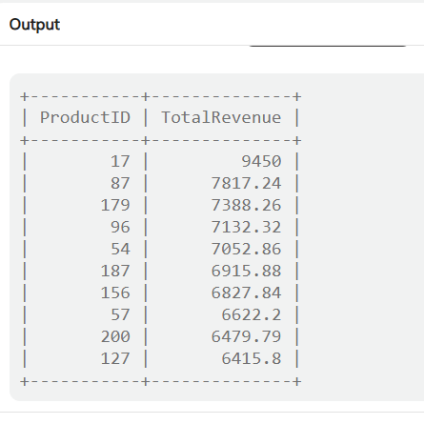
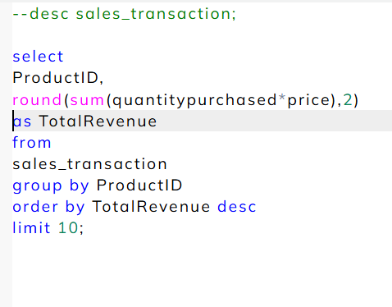
Problem Statement:
High Sales Products
SQL QUERY
Analysis:
The analysis identifies the top-performing products based on total revenue generated. Product ID 17 recorded the highest sales, followed by products 87 and 179. These insights help the business focus on high-demand items, optimize inventory planning, and design targeted promotions to boost overall sales performance.

Slide 14
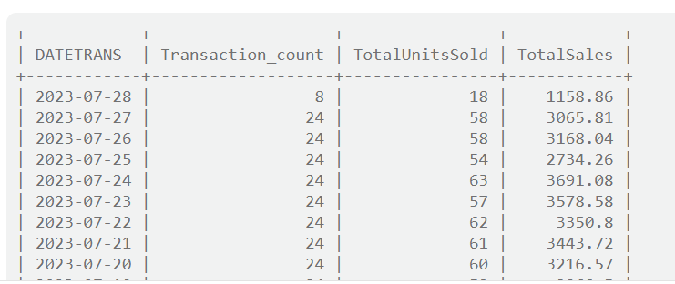
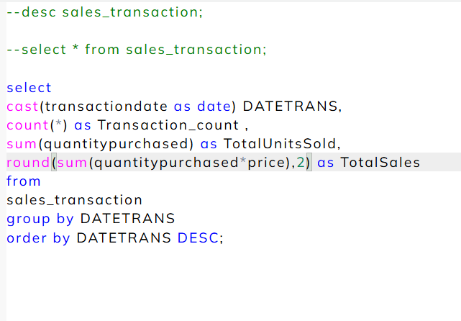
Problem Statement:
Sales Trend
SQL QUERY
Analysis:
The analysis tracks daily sales performance by summarizing total transactions, units sold, and revenue over time. The data shows fluctuations in sales volume, indicating varying customer activity across dates. These insights help identify peak sales days, assess seasonal trends, and support data-driven sales forecasting.

Slide 15
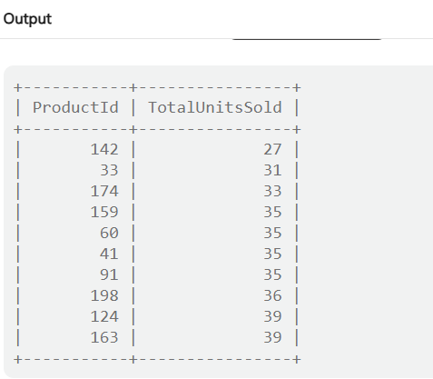
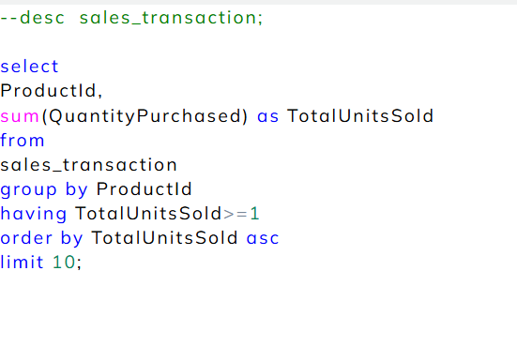
Problem Statement:
Low Sales Products
SQL QUERY
Analysis:
The analysis identifies products with the lowest sales volumes, such as Product IDs 142 and 33, which have minimal customer demand. These findings help the business assess underperforming items, optimize inventory management, and plan targeted promotional or discount strategies to improve sales performance.

Slide 16
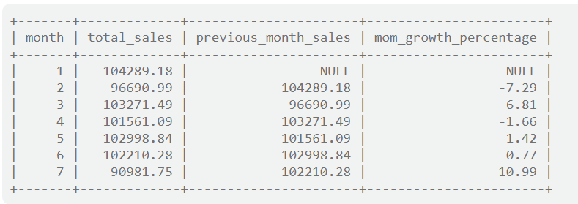
Problem Statement:
Growth Rate of Sales
Analysis:
The analysis tracks the month-over-month (MoM) sales growth to evaluate performance trends over time. While some months show positive growth (e.g., Month 3 with +6.81%), others reflect a decline (e.g., Month 7 with -10.99%), indicating fluctuating sales performance. These insights help identify strong and weak periods, enabling better forecasting and targeted sales improvement strategies.

Slide 17
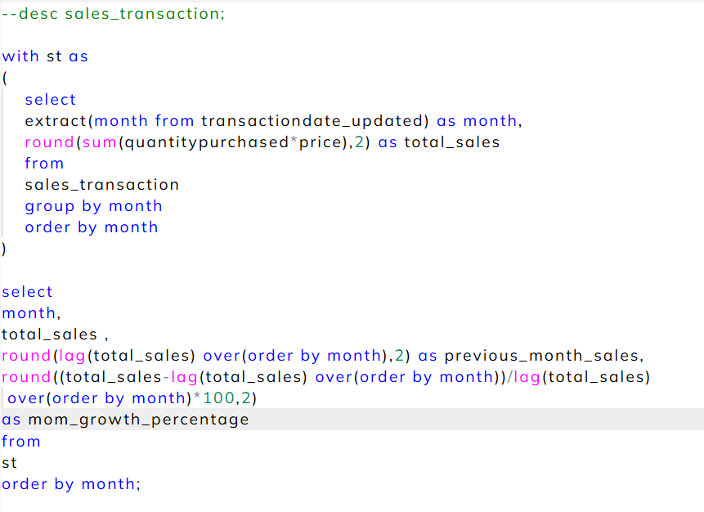
SQL QUERY

Slide 18
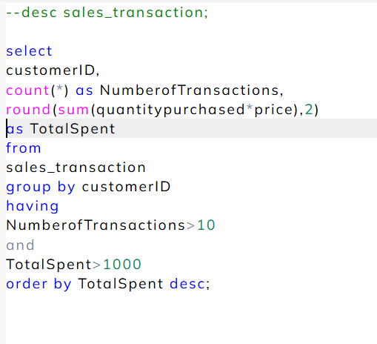
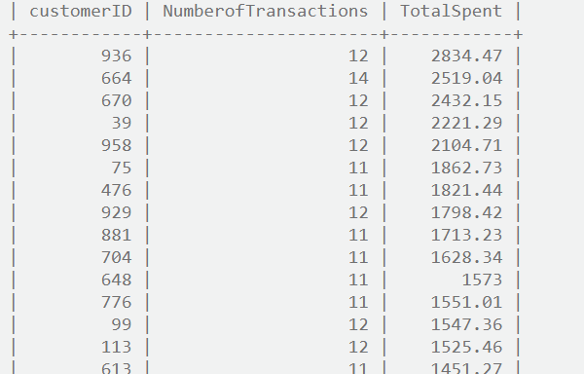
Problem Statement:
High Purchase Frequency
SQL QUERY
Analysis:
The analysis identifies high-value customers with more than 10 transactions and total spending above 1000. Customers like IDs 936 and 664 show strong purchase frequency and loyalty. These insights help in targeting premium customers with personalized offers, loyalty programs, and retention-focused marketing strategies.

Slide 19
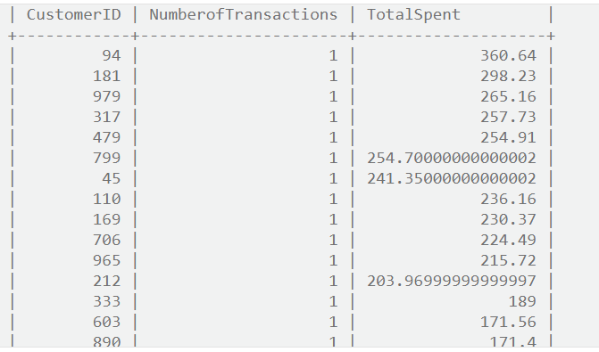
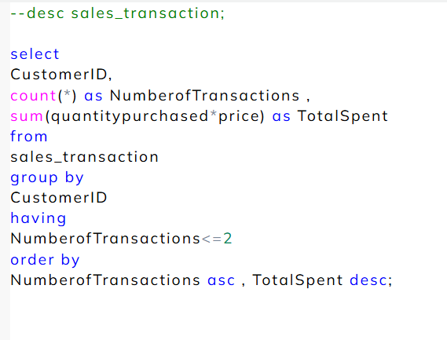
Problem Statement:
Occassional Customers
SQL QUERY
Analysis:
The analysis identifies occasional customers who have made only one or two purchases. These low-frequency buyers contribute minimally to total revenue but represent potential growth opportunities. Targeted re-engagement strategies, such as personalized discounts or loyalty offers, can help convert them into repeat customers and boost retention.

Slide 20
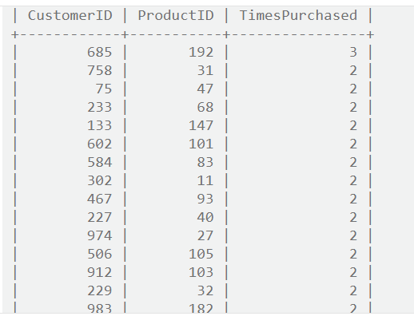
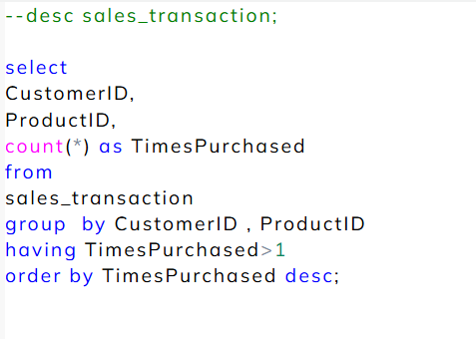
Problem Statement:
Repeated Purchases
SQL QUERY
Analysis:
The analysis identifies customers who made repeated purchases of the same products, indicating strong brand or product loyalty. Customers like ID 685, who purchased Product 192 multiple times, highlight valuable retention opportunities. These insights can guide loyalty programs, cross-selling efforts, and personalized marketing to enhance repeat sales.

Slide 21
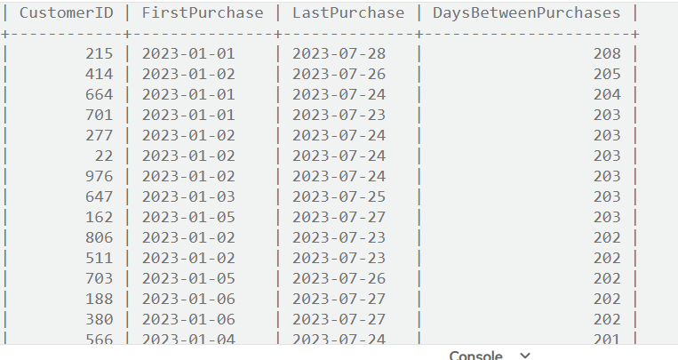
Problem Statement:
Loyalty Indicators
Analysis:
The analysis measures customer loyalty by calculating the number of days between each customer's first and last purchase. Customers with longer engagement periods, such as IDs 215 and 414, show consistent purchasing behavior over several months. These insights help identify loyal customers and evaluate retention effectiveness, guiding customer relationship and loyalty strategies.

Slide 22
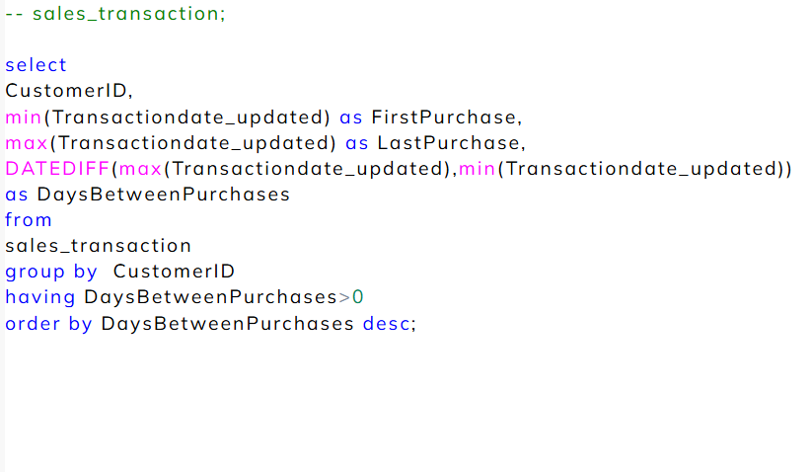
SQL QUERY

Slide 23
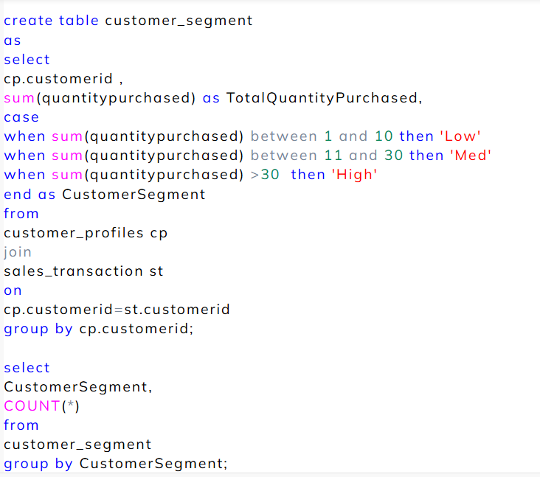
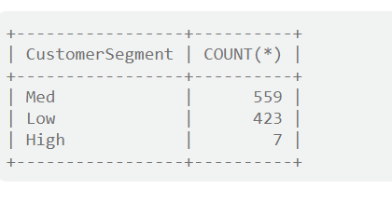
Problem Statement:
Customer Segmentation
SQL QUERY
Analysis:
The analysis segments customers based on total quantity purchased into Low, Medium, and High value groups. The majority of customers fall under the Medium segment (559), followed by Low (423) and a few High-value customers (7). This segmentation helps in tailoring marketing campaigns, optimizing engagement strategies, and prioritizing resources toward high-value customers.

